Slide 1
Predicting the optimal location for a new Fast Food Chain in Brooklyn
Alessandro Morello – the battle of neighborhoods Capstone Project

Slide 2
Predicting the optimal location for a new Fast Food Chain in Brooklyn
1
Introduction
The main objective of this project is to predict the best possible location for a new fast food restaurant chain aimed to help the business choose the right neighbourhood that can quickly overcome the initial loss and expensive in the shortest timeframe possible. In order to do this i will rely on the already available data and compare it to our needs, analysing all the possibilities based on all the neighbours that will hopefully help me in predicting one or more ideal location.

Slide 3
Predicting the optimal location for a new Fast Food Chain in Brooklyn
2
Data used and basic stats
The data used in order to solve the problem will be a combination between a publicly available data and the precious help of our Foursquare API, below in a more detailed list:
1. NYC neighbours dataset with locations: https://geo.nyu.edu/catalog/nyu_2451_34572
2. Foursquare API - neighbours
3. Foursquare API - venues
4. Foursquare API - other amenities
The data can be quantified as follows:
69 different neighborhoods
30 different types of venues

Slide 4
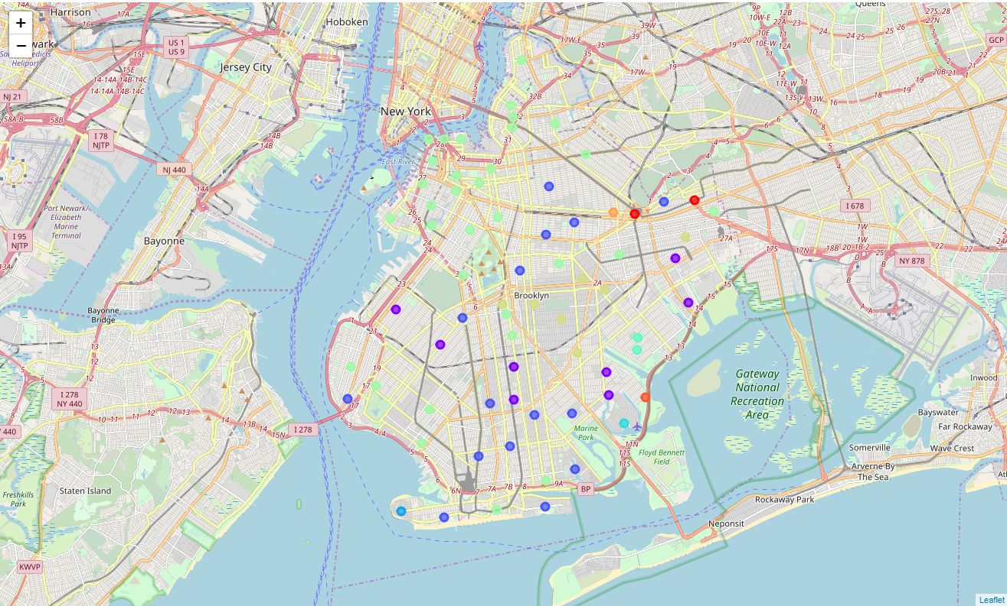
Predicting the optimal location for a new Fast Food Chain in Brooklyn
3
A visual aid on clusters
With the help of machine learning and k-means we managed to divide the neighborhoods in clusters.

Slide 5
Predicting the optimal location for a new Fast Food Chain in Brooklyn
2
Conclusions
From the mentioned data we can analyse the most suitable location for the new Fast Food Restaurant Chain to be opened. It is imperative in this case that the neighbourhood is surrounded by the highest number of Restaurants, Grocery and other utility shops close by. For this specific reason we took into consideration the clusters where the top 5 venues were in regards of food places and discard other venues. For these reasons, i have chosen the Rugby and Remsen village as the most feasible choices.
We can state that in this specific analysis, the applying of k-clustering means helped us to find the most ideal place to start the type of business mentioned in this capstone project.

Slide 6
THANK YOU!

